Slide 1
The Linear Regression Model (线性回归）
Based on Statistic course given by Kyle Tomlinson
Peili Fu
2021.09.11

Slide 2
Simple linear regression
The linear model:
Can use a linear model to describe the relationship between x and y:
y_{i} is the response variable （因变量）
x_{i} is the predictor variable. （自变量）
y
β₀ is the intercept (the value of y when x = 0) 截距
β₁ is the slope of the regression 斜率
(the change in y for every unit of x)
x

Slide 3

Simple linear regression
The linear regression model:
Can use a linear regression to fit a best linear relationship between x and y for some data:
y
Here:
i are pairs of (x,y) values measured,
y_{i} is the response variable
x_{i} is the predictor variable
Ɛ_{i} are the distances between
observed y_{i} and predicted
$$ε_{i}$$
x

Slide 4

Regression calculation
Simple regression uses the method of Ordinary Least squares estimation (OLS): 最小二乘法
regression fits the best line through the data by
minimising the sum of squared errors: 方差最小
This requires differentiation w.r.t. β₀ and β₁.
对β₀ and β₁进行求解
y
$$ε_{i}$$
x

Slide 5
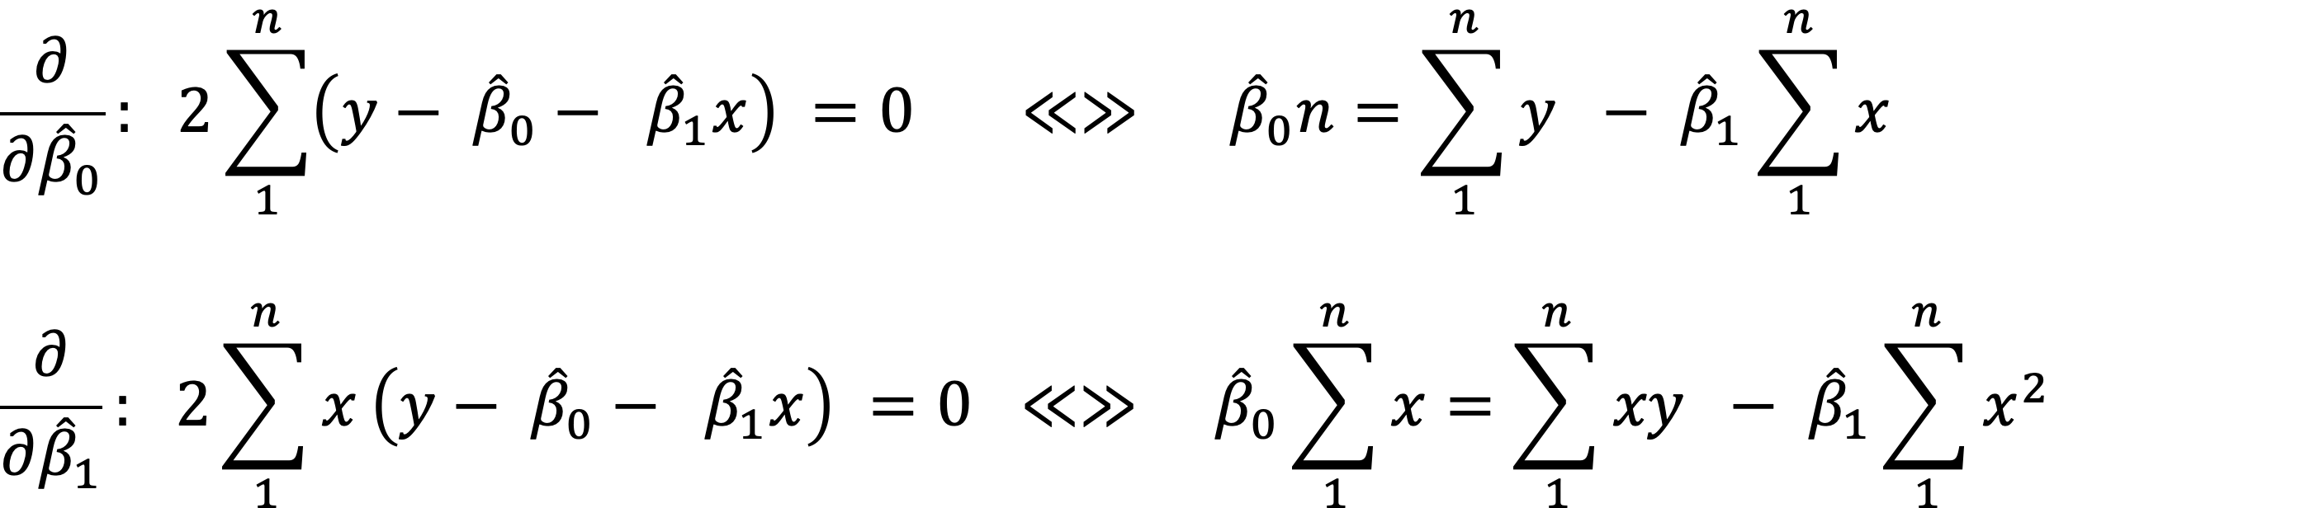
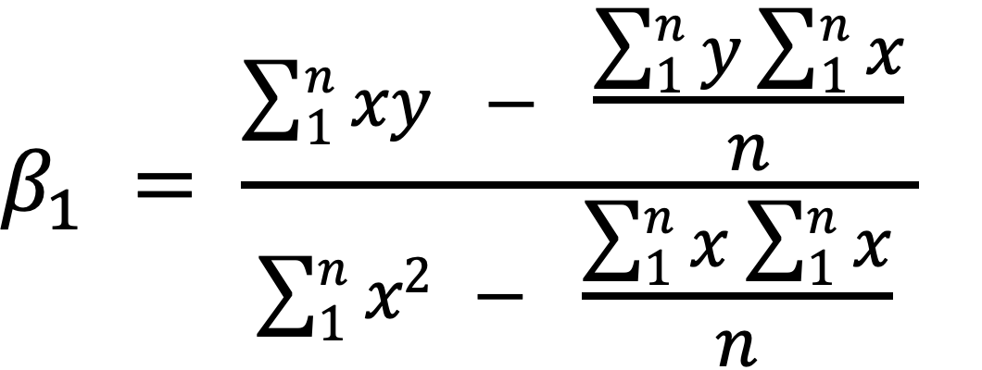
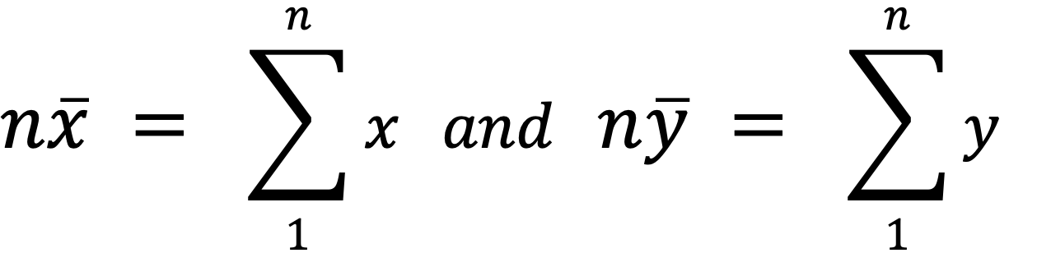
Finding the coefficients, β_{i}
Take partial derivatives （偏导数） wrt to β₀ （截距） and β₁ （斜率）
Solve for β₁ by equating β₀
_{wher}

Slide 6
Finding the coefficients, β_{i}
To calculate the slope (β₁) we need to calculate:
This can also be written as:
To calculate intercept (β₀):

Slide 7
Estimating the residual variance （残差）
Statistical tests require the residual variance of the model to quantify the uncertainty (s.e.) of β_{i}

Slide 8



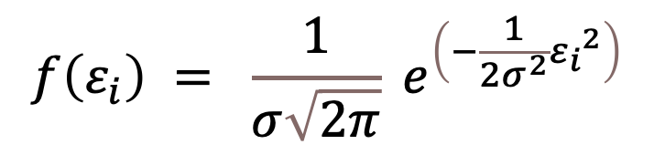
The normal distribution (正态分布）
The residuals, $ε_{i}$, of this model are assumed to follow the normal distribution with mean $μ$, and variance $σ$².
y
$$ε_{i}$$
x
$$f\left(ε_{i}\right) = \frac{1}{σ\sqrt{2π}} e^{\left(−\frac{1}{2σ^{2}}{ε_{i}}^{2}\right)}$$
0
$$ε_{i}$$

Slide 9
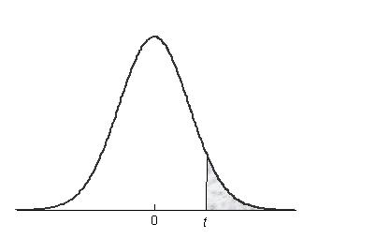

Hypothesis testing （假设检验）
Main hypothesis: the slope, β₁ ≠ 0
H₀: β₁ = 0
y
x
Coefficients:
Estimate s.e. t value Pr(>|t|)
(Intercept) 22.440 3.4841 6.441 1.55e-05 ***
Temperature 1.015 0.2379 4.268 0.000781 ***

Slide 10
Interpreting linear models
Linear models can deal with both continuous and categorical predictor variables simultaneously
Ordinal predictors = variates (e.g. age)
(continuous/discrete)
Categorical predictors = factors (e.g. sex)

Slide 11
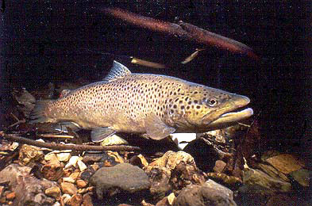

Example 1A
A researcher measures the maximum swimming speed of 10 brown trout and 10 Canterbury galaxias at a range of temperatures.
Response (Y) = swimming speed
Predictor Factor = species → dummy variable (D)
Predictor Variate (X₁) = temperature

Slide 12
Example 1A
哑变量
 |  | X₁ | Y | D
Obs. No. | Species | Temperature (ºC) | Speed (cm/s) | Dummy Variable
1 | Trout | 3 | 48.1 | 0
2 | Trout | 6 | 51.2 | 0
3 | Trout | 11 | 73.1 | 0
4 | Trout | 12 | 78.1 | 0
5 | Trout | 15 | 81.1 | 0
6 | Trout | 21 | 94.5 | 0
7 | Trout | 24 | 99.0 | 0
8 | Trout | 26 | 115.3 | 0
9 | Trout | 28 | 113.7 | 0
10 | Trout | 30 | 118.7 | 0
11 | Galaxias | 4 | 26.1 | 1
12 | Galaxias | 9 | 33.7 | 1
13 | Galaxias | 12 | 31.4 | 1
14 | Galaxias | 14 | 38.5 | 1
15 | Galaxias | 15 | 36.9 | 1
16 | Galaxias | 17 | 39.1 | 1
17 | Galaxias | 18 | 42.2 | 1
18 | Galaxias | 21 | 43.3 | 1
19 | Galaxias | 25 | 58.9 | 1
20 | Galaxias | 28 | 54.3 | 1

Slide 13
Dummy Variables (虚拟变量)
What is a Dummy Variable?
A dummy variable (aka, an indicator variable) is a numeric variable that represents categorical data, such as gender, race, political affiliation, etc.
Technically, dummy variables are dichotomous, quantitative variables. Their range of values is small; they can take on only two quantitative values. As a practical matter, regression results are easiest to interpret when dummy variables are limited to two specific values, 1 or 0. Typically, 1 represents the presence of a qualitative attribute, and 0 represents the absence.
虚拟变量 又称虚设变量、名义变量或哑变量，用以反映质的属性的一个人工变量，是量化了的自变量，通常取值为0或1。引入哑变量可使线形回归模型变得更复杂，但对问题描述更简明，一个方程能达到两个方程的作用，而且接近现实。

Slide 14
Example 1.1
Open the data “fishspeed.csv” in R
(1) Run speed as a function of temperature using lm(). Write out the model.
(2) Run speed as a function of species using lm(). Write out the model.
(3) Compare fishspeed of species using t.test() (please specify: var.equal=TRUE)
(4) Compare (2) and (3)

Slide 15
Example 1A: some output
Note that the lm() output gives you the β estimates with standard errors plus t-tests evaluating significance
The output also gives you an R² value, which is a goodness-of-fit measure (how well model explains data)
It also gives you the residual standard error = sqrt(σ²), from which the coefficient s.e.’s are derived.
Coefficients:
Estimate s.e. t value Pr(>|t|)
(Intercept) 17.340 11.967 1.449 0.1667
Temperature 2.979 0.677 4.401 0.0004 ***

Slide 16
Example1.2
Matrix OLS solution of LM
Use the fishspeed data to solve the beta coefficients for:
(1) Speed ~ Temperature
(2) Speed ~ Species

Slide 17
Multi-linear models （多个线性模型）
The underlying linear models can be extended from simple linear models
to models with multiple variables and interactions.
$$y_{ijk}= β_{0}+β_{1}x_{1}+β_{2}x_{2} +β_{3}x_{1}x_{2}+ε_{ijk}$$

Slide 18
Interpreting multilinear models
Regression models with factors and variables have separate regression lines for each factor level
Y
b₁
1
b₁
1
X₁

Slide 19
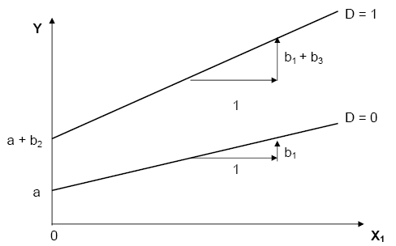
Modelling interactions
a = intercept for level 1 (D=0)
b₁ = regression slope for level 1
b₂ = difference in intercepts of the two lines = Y₁ – Y₂ when X =0
b₃ = difference in slopes of the two lines

Slide 20
Fishspeed Example
A researcher measures the maximum swimming speed of 10 brown trout and 10 Canterbury galaxias at a range of temperatures.
NOW he wants to know whether the two fish species respond differently to temperature.
=> INTERACTION

Slide 21
Recall the data
 |  | X₁ | Y | D
Obs. No. | Species | Temperature (ºC) | Speed (cm/s) | Dummy Variable
1 | Trout | 3 | 48.1 | 0
2 | Trout | 6 | 51.2 | 0
3 | Trout | 11 | 73.1 | 0
4 | Trout | 12 | 78.1 | 0
5 | Trout | 15 | 81.1 | 0
6 | Trout | 21 | 94.5 | 0
7 | Trout | 24 | 99.0 | 0
8 | Trout | 26 | 115.3 | 0
9 | Trout | 28 | 113.7 | 0
10 | Trout | 30 | 118.7 | 0
11 | Galaxias | 4 | 26.1 | 1
12 | Galaxias | 9 | 33.7 | 1
13 | Galaxias | 12 | 31.4 | 1
14 | Galaxias | 14 | 38.5 | 1
15 | Galaxias | 15 | 36.9 | 1
16 | Galaxias | 17 | 39.1 | 1
17 | Galaxias | 18 | 42.2 | 1
18 | Galaxias | 21 | 43.3 | 1
19 | Galaxias | 25 | 58.9 | 1
20 | Galaxias | 28 | 54.3 | 1

Slide 22
Example: 1.3
The Fishspeed data
Formulate the linear model
Run the regression model in R
Write out the solution model

Slide 23
Results: coefficients
Model for galaxias:
Speed = 22.440 + (1.015*Temp)
Model for trout:
Speed = 22.440 + (1.015*Temp) + (18.356) + (1.626*Temp)
Speed = 40.796 + (2.641*Temp)
Coefficients:
Estimate Std. Error t value Pr(>|t|)
(Intercept) 22.4405 3.4841 6.441 1.55e-05 ***
Temperature 1.0152 0.2379 4.268 0.000781 ***
SpeciesTrout 18.3559 4.2037 4.367 0.000645 ***
SpeciesTrout:Temperature 1.6259 0.2660 6.113 2.68e-05 ***

Slide 24
Results: coefficients
b₁ > 0: swimming speed of galaxias increases with temp.
b₂ > 0: swimming speed of trout is greater than that of galaxias at 0ºC (intercept)
b₃ > 0: temperature has higher effect on swimming speed of trout than on galaxias.
i.e. Temperature effect depends on species
Coefficients:
Estimate Std. Error t value Pr(>|t|)
(Intercept) 22.4405 3.4841 6.441 1.55e-05 ***
Temperature 1.0152 0.2379 4.268 0.000781 ***
SpeciesTrout 18.3559 4.2037 4.367 0.000645 ***
SpeciesTrout:Temperature 1.6259 0.2660 6.113 2.68e-05 ***

Slide 25
Multilevel Linear Models
Models with factors are evaluated by considering differences between particular levels and a chosen reference level (the default case)
When a factor has more than 2 levels, we need to change the default case multiple times to ensure that we cover all pairwise comparisons

Slide 26
Exercise: 1.3

Slide 27
Principle of marginality
The principle of marginality states that the main effects of a model are marginal to high order terms (such as an interaction). Therefore models should include all lower-order relatives of that higher order term (e.g. the main effects that comprise the interaction).
In other words, the main effects, of species and temperature are marginal to the species*temperature interaction. 主效应相对于交互作用是微不足道的。
Notes:
在线性模型中，更高级别的系数更重要，比如斜率比截距重要，交互作用比主效应更重要。如果交互作用显著，则所用的主效应均需要列出来。

Slide 28
Assumptions of linear models
IMPORTANT!
Things we need to check (consider) when using linear regression models

Slide 29
Assumptions of linear models （线性模型的假定）
$$y_{ijk}= β_{0}+β_{1}x_{1}+β_{2}x_{2} +β_{3}x_{1}x_{2}+ε_{ijk}$$
Linear models make many assumptions, including:
The model makes biological sense/ physical sense 生物或物理意义
Additivity (terms are added together) 可加性
Linearity 线性
Independence of errors (LATER) 残差独立
Homoscedasticity – equal variance of errors 方差均质
Normality of errors. 残差正态

Slide 30
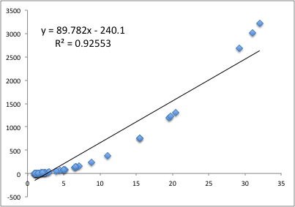
Linearity
If the relationship is not linear, then the fitted model will not fit the data properly across the domain of values

Slide 31
Linearity
Linearity:
How do we check it?
(1) Plot the raw data:
> plot(x,y)
> model<-lm(y~x)
> lines(x,model$fitted)

Slide 32
Linearity
What’s the solution?
Transform the response
Transform the predictors
e.g. Polynomial regression
THINK ABOUT WHAT RELATIONSHIP IS NATURALLY MEANINGFUL (ASSUMPTION 1)

Slide 33
Distribution of residuals
The parametric tests are mathematically derived, based on assumed distributions (e.g. normal, F)
Which means the tests can only be trusted when the data being tested follow the assumed distributions
e.g. t-tests and F-tests assume residuals are approximately normally distributed

Slide 34
Normality
.. the residuals of the model should be normally distributed
Why? Because t-tests and ANOVA assume normal residuals!
Frequency
0
Residuals

Slide 35
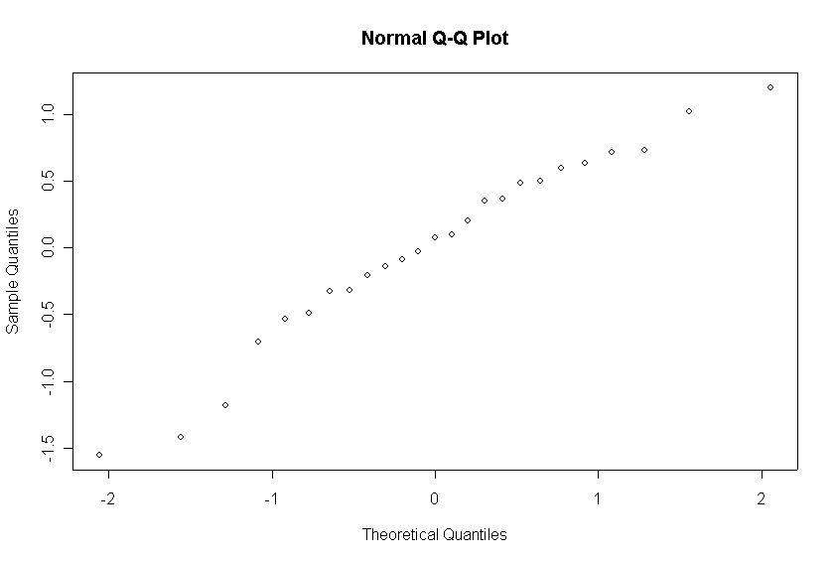
Normality
How do we check it?
Normality of residuals can be checked using a q-q plot

Slide 36
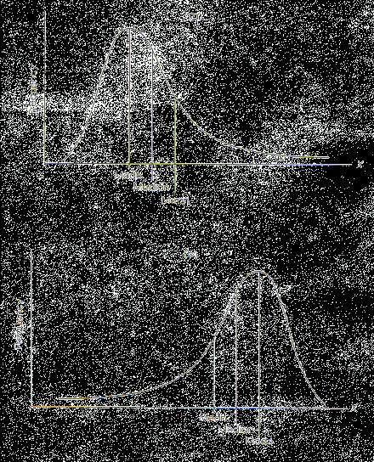
Distribution of residuals
Most common problem is positive skew:
Solution? Transform response variable
P
ositive

Slide 37
Homoscedasticity（同质性）
Homogeneity of variances (Homoscedasticity):
i.e. the residuals (e_{i}’s) should have the same variance across values of the response variable
If not, then parameter estimates are likely to be unreliable

Slide 38
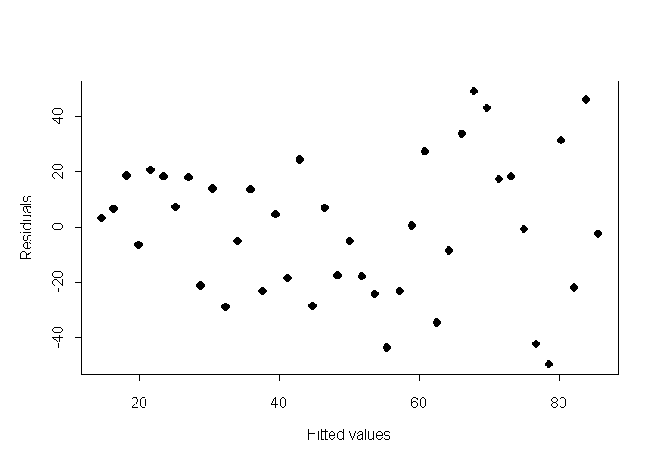
Homoscedasticity
How do we check it?
1) Plot residuals ( ) against fitted values ( )
Residuals should be evenly spread across the range of fitted values

Slide 39
Homoscedasticity
What can cause the assumption to be broken?
Skew (response or predictors require transformation)
Outliers
What’s the solution?
Transform the response variable or predictor variables

Slide 40
Checking diagnostics
This is easily done in R for lm() models
Use the plot() function on the derived lm() object and it will plot the errors for you.

Slide 41
Example: 1.4
Return to the fishspeed2 problem.
Run diagnostic plots for the model you constructed there

Slide 42
Diagnostics plot for lm() in R

Slide 43
End of Lecture 1

